Slide 1
Sensory
input
Movement
PRC
PHC
Place
recognition
Landmark
identity
Lateral
EC
Medial
EC
Grid cells
Place cells
Landmark
vector cells
Hippocampus
Subiculum
Border
cells, BVCs
Notes:
Landmark location:
The identification of landmark-vector cells in the hippocampus (cells that fire when the rat is located at a specific distance and direction from an object in the environment) suggests that such an object-based spatial signal does enter the hippocampus [42].

Slide 2
m_{t-1}
m_{t}
m_{t+1}
m_{T}
x_{t-1}
x_{t}
x_{t+1}
x_{T}
…
O_{t-1}
O_{t}
O_{t+1}
O_{T}
L
l₁
l₂
l_{N}
…

Slide 4
Full SLAM BN
Local inference
Global loop closure
Neur corr
Example firing fields

Slide 5
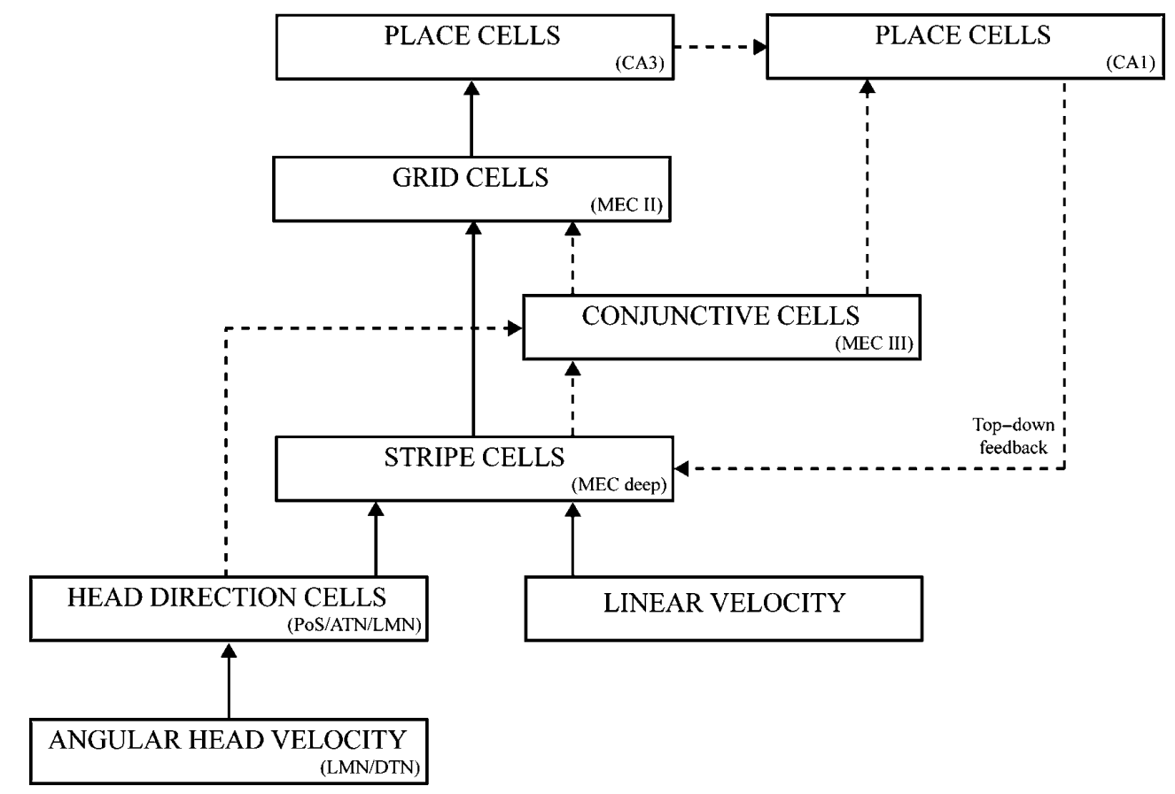
Notes:
Pilly & grossberg 2012

Slide 6
